Slide 1
Goodman Gold Challenge

Slide 2
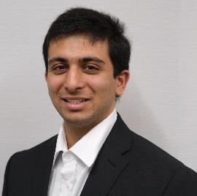
Meet the Team
Calum Passi
Joshua Bisaillon
Karen Gill
Jay Gosai
Faculty of Management
Class of 2025
Faculty of Management
Class of 2025
Faculty of Engineering
Class of 2025
Faculty of Engineering
Class of 2025

Slide 3
Cautionary Statement:
The information provided herein, by the Laurentian University Goodman Gold Challenge Team is derived from publicly available sources. The analysis provided may include certain statements, estimates, and projections related to the historical and forward-looking operational performance of select mining companies.
These statements, estimates, and projections are based on various assumptions made by the Laurentian University Goodman Gold Challenge Team concerning the anticipated performance of G Mining Ventures, Meridian Mining, Omai Gold Mines and other comparable companies. As such, the information presented below is subject to significant economic uncertainty and should not be taken as professional financial advice.
The Laurentian University Goodman Gold Challenge Team does not assume responsibility or liability for any error, inaccuracy, or omission contained that may be made of such information by the reader. No information should be replicated or referenced without prior consent from the Laurentian University Goodman Gold Challenge Team.

Slide 4
Land Acknowledgement:
We graciously acknowledge that our gathering takes place today on Robinson-Huron Treaty Territory. Additionally, we’d like to express gratitude and respect to the Atikameksheng Anishinabek, upon whose traditional lands Laurentian University proudly stands.
We also acknowledge that Sudbury encompasses traditional lands of the Wanapitei First Nations, whose deep connection to the land is an integral prat of our community.

Slide 5
Table of Contents:
1
Executive Summary
2
Overview
3
Investment Criteria
4
Technical Analysis
5
Financial Analysis
6
Valuation
6
Proposal

Slide 6
Executive Summary
Recommendation: Meridian Mining
G Mining Ventures
Speculation: BUY
Valuation: C$1.72/share
Share price has built in all potential
Updated PEA
5%
CA$1.31
No near-term catalysts to return profit
Bargain Value
Base Case – S2
60%
CA$1.61
Potential issues with CentroGold
Feasibility
Best Case –S3
20%
CA$2.49
Omai Gold Mines
Street
15%
CA$1.30
Technicals
Profit: 3.01x
Technical risk associated with Gilt Creek
High financing risk
Heavy reliance on MNA outcome
Executive Summary Overview Investment Criteria Technical Analysis Financial Analysis Valuation Proposal

Slide 7
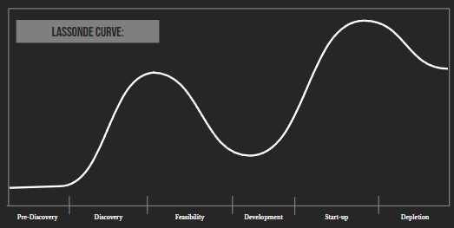
Overview: G Mining Ventures (TSX:GMIN)
$2,000 USD per ounce
Value Captured in Economically Viable Gold:
Since G Mining Ventures set very low gold price estimates in their technical reports they benefit from hidden value in the newly economically viable gold
1
Cash Flow Generation:
Since Tocantinzinho has entered the production phase, the company can generate cash flow, enabling more strategic allocation of its funds
2
Tocantinzinho
NPV = 1.15 billion
IRR = 58.57%
Payback = 2.80 yrs
Mine life = 10.5yrs
Mine Building Expertise: GMIN has successfully built 5 mines in South America which is a testament to their expertise and moto of “Buy. Build. Operate”
3
Oko West
NPV = 1.367 billion
IRR = 20.8%
Payback = 3.8 yrs
Mine life = 12.7 yrs
CentroGold
NPV = 842 million
IRR = 130%
Payback = 0.70yrs
Mine life = 10 yrs
Executive Summary Overview Investment Criteria Technical Analysis Financial Analysis Valuation Proposal

Slide 8
Overview: G Mining Venture (TSX:GMIN)
Project Value
Tocantinzinho + Oko West
Economically Viable Gold
Executive Summary Overview Investment Criteria Technical Analysis Financial Analysis Valuation Proposal

Slide 9
Overview: G Mining Ventures (TSX:GMIN)
Financial Indicators
+135 yrs
Executive Team
Cumulative Experience
Share Price
13.20
Enterprise Value
2.98B
52 week-high
13.38
Market Cap
2.97B
52 week-low
6.72
Shares Outstanding
225M
Performance 1Y
41.63%
P/NAV
20.09
Margin of Profit
1.52x
+300 yrs
Board of Directors
Cumulative Experience
Recent Performance
Cumulative Experience
0/7
Insider Members
Executive Summary Overview Investment Criteria Technical Analysis Financial Analysis Valuation Proposal

Slide 10
Overview: OMAI Gold Mines Corp. (TSXV:OMG.V)
$2,000 USD per ounce
Lowest Ev/AuEq:
High quantities of contained gold coupled with low shareholder dilution places the company in an advantageous position if looking to be acquired by major gold companies
1
Pre-existing Infrastructure:
Previous mining ventures in conjunction with strong road access, a strong database, and an enthusiastic workforce allow the company to have a low discovery cost.
2
Wenot
NPV = 863M
IRR = 41.78%
Payback = 3.58yrs
Mine Life = 20+ yrs
Many near-term Catalysts:
Short-term drilling discoveries, royalty negotiations, and possible acquisition
3
Gilt Creek
Executive Summary Overview Investment Criteria Technical Analysis Financial Analysis Valuation Proposal

Slide 11
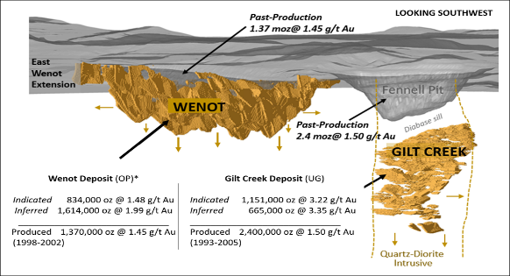
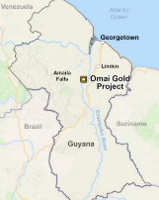
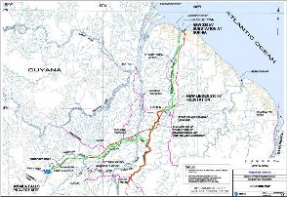
Overview: OMAI Gold Mines (TSXV:OMG.V)
Pro-rated Potential
PEA of Wenot (78% capacity)
Infrastructure
Executive Summary Overview Investment Criteria Technical Analysis Financial Analysis Valuation Proposal

Slide 12
Overview: OMAI Gold Mines Corp. (TSXV:OMG.V)
Financial Indicators
+135 yrs
Executive Team
Cumulative Experience
Share Price
C$0.29
Enterprise Value
137M
1.68%
Insider Ownership
52 week-high
C$0.29
Market Cap
148M
52 week-low
C$0.06
Shares Outstanding
520M
CEO & President
CFO
VP of Corporate Development
VP of Operations
Performance 1Y
375%
EV/Contained Au
C$8.19
P/NAV
2.38
Margin of Profit
7.2x
+150 yrs
Board of Directors
Cumulative Experience
Recent Performance
Cumulative Experience
1/6
Insider Member
Executive Summary Overview Investment Criteria Technical Analysis Financial Analysis Valuation Proposal

Slide 13
Overview: Meridian Mining (TSX:MNO)
$2,000 USD per ounce
High-Grade Starter Pit:
Hosting 3Mt of AuEq @ 2.5g/t the starter pit offers quick cash flow that allows Meridian to bolster a much lower payback period .
1
Synergistic Projects:
Since Meridian ‘s properties are in close proximity they benefit from shared infrastructure (e.g. mill, hydroelectric dam, etc…
2
Ariquemes
Many near term developments: Meridian plans to publish the PFS and FS for its Cabacal property in 2025 and secure its preliminary license for Santa Helena within the same year. This presents an opportune time to invest for those confident in their ability to meet these milestones
3
Cabacal
NPV = 804.72M
IRR = 42.48%
Payback = 1 yr
Mine life = 23yrs
Espigão
Santa Helena
High grade open-pit
Infill drilling
Expansive drilling
Preliminary License
Mirante De Serra
Executive Summary Overview Investment Criteria Technical Analysis Financial Analysis Valuation Proposal

Slide 14
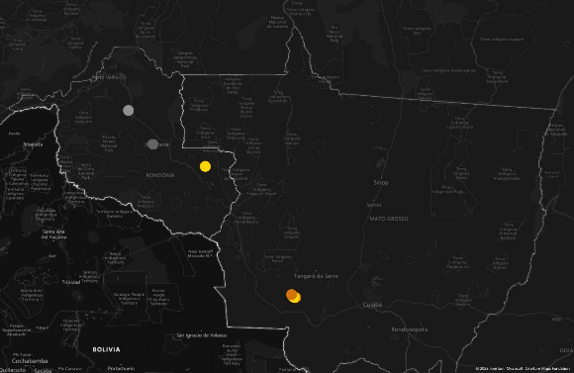
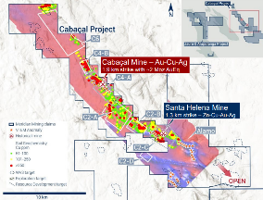
Overview: Meridian Mining (TSX:MNO)
Meridian Mining Map
Cabacal Production Timeline
Santa Helena Resource Estimates
Executive Summary Overview Investment Criteria Technical Analysis Financial Analysis Valuation Proposal

Slide 15
Overview: Meridian Mining (TSX:MNO)
Financial Indicators
+500 yrs
Executives & Management
Cumulative Experience
Share Price
CA$0.41
Enterprise Value
104M
52 week-high
C$0.61
Market Cap
119M
52 week-low
C$0.25
Shares Outstanding
305M
Performance 1Y
22.73%
EV/Contained Au
97.29
P/NAV
3.70
Margin of Profit
7.6x
+195 yrs
Board of Directors
Recent Performance
Cumulative Experience
2/7
Insider Members
Executive Summary Overview Investment Criteria Technical Analysis Financial Analysis Valuation Proposal

Slide 16
Investment Criteria:
Technical Criteria
Financial Criteria
✔
Does the project have the infrastructure required?
✔
Does the company have access to the financing they need?
✔
Does the project operate within a mining friendly jurisdiction?
✔
Does the management team have the expertise to achieve their goal?
✔
Does the project garner positive geopolitical sentiment?
✔
Is the company in a favourable position to capitalize on high gold prices?
✔
Does the company have long-term growth opportunities?
✔
Is the company able to return money to the investor quickly?
✔
Does the company have the labour force to operate as promised?
✔
Is the level of shareholder dilution acceptable?
✔
Do the timeframes promised seem feasible?
✔
Does the company stack up well against its relative competitors?
✔
Is the company able to adapt in the case of a downturn?
✔
Does the company perform under a stress test?
✔
Are the companies resource estimates attractive?
✔
Does the valuation of the company indicate that it's trading at a bargain?
Executive Summary Overview Investment Criteria Technical Analysis Financial Analysis Valuation Proposal

Slide 17
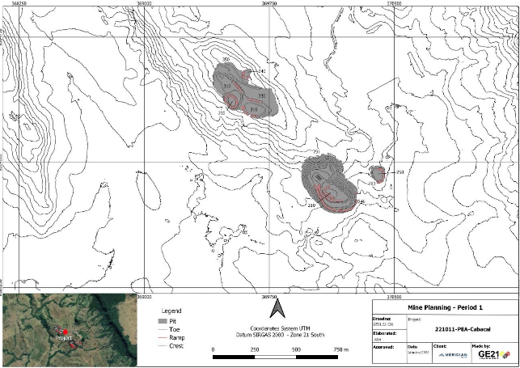
Technical Analysis – Advantages of Meridian Mining
High-Grade Initial Pit:
Hosting 3Mt of AuEq @ 2.5g/t the initial pit location offers quick cash flow that allows Meridian to achieve an industry leading payback period.
1
Near Surface Ore:
The economically viable ore has been found in near surface deposits (VMS), which
lower transportation costs and equipment wear.
2
Metallurgical Diversity The project is based on the Cabacal VMS belt, which is a highly diversified resource consisting of Gold, Silver, Copper and Zinc assets
3
Infrastructure Availability
The Cabacal site has access to key utility infrastructure such as nearby power (hydro-electric dams), roads, and railways to support operations
4
Tailings Storage and Processing:
It has been established that the present tailings on-site will be reprocessed in the mill for gold recoveries, and a dry stack tailings structure will be used.
5
Synergistic Projects:
Since Meridian ‘s properties are in close proximity to each other, they benefit from shared infrastructure (e.g. mill, hydroelectric dam, etc.)
6
Executive Summary Overview Investment Criteria Technical Analysis Financial Analysis Valuation Proposal

Slide 18
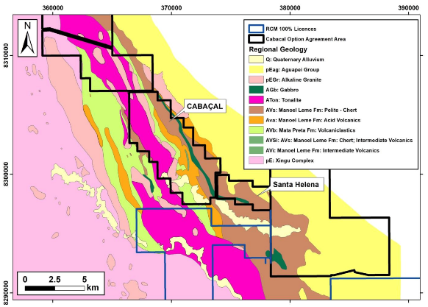
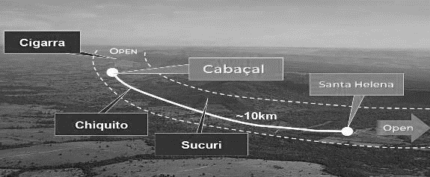
Meridian Project Geology
Cabacal Geology Map
VMS Deposit
PEA - Resources
Category
Mt
Au (g/t)
Cu (%)
Cu (Kt)
AuEq (Moz)
Indicated
52.9
0.64
0.32
168
1.8
Inferred
10.3
0.68
0.24
24.5
0.3
Executive Summary Overview Investment Criteria Technical Analysis Financial Analysis Valuation Proposal

Slide 19
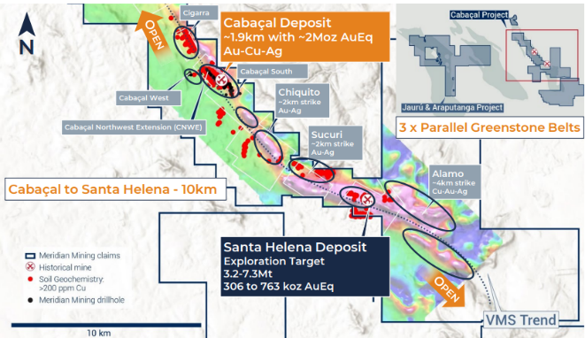
Technical Analysis – Drilling
2021-2022 Drilling Campaign
Goal was to validate the historical database from previous drilling activities.
Twin drill holes to avoid "nugget effect"
Infill holes to improve knowledge of resource, especially in known higher grade regions
Extension of exploration holes to further delineate the extents of the mineralization
Total Drilled Length
22,890 meters
Total Drill Holes
184
Ongoing Exploration and Drilling
Ongoing exploration of the 10km region of Cabacal and Santa Helena will be focused on decreasing the drill hole spacing, especially in known high grade areas. Additional exploration of the Santa Helena deposit will be important to proceed with plans for development.
Executive Summary Overview Investment Criteria Technical Analysis Financial Analysis Valuation Proposal

Slide 20
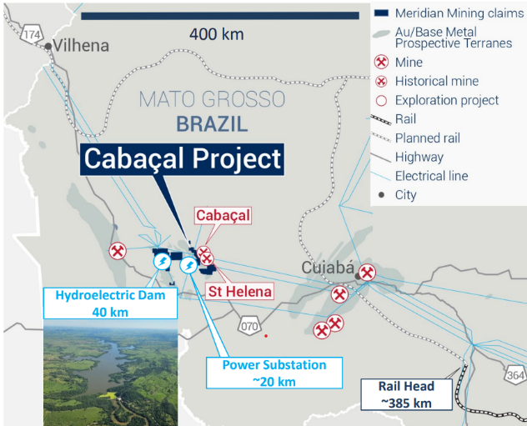
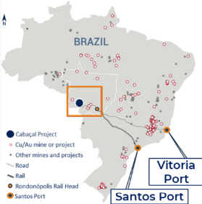
Technical Analysis – Infrastructure and Services
Site Access:
30km from Cabacal lies São José dos Quatro Marcos (population 18,846) via unpaved , all weather gravel roads. A 0.7km 2-lane gravel site access road is still required.
1
Hydroelectric Dams – Demand of 10 MW
According to the information we’ve precured, the ≈ 10 hydroelectric dams are sufficient to power Cabacal’s operations
2
Transmission Lines
A 20km transmission line is required to connect to the closest substation
3
Rail Transport
Existing rail-way tie in is located ≈ 385km SE of Cabacal. Note that there are plans in place for a new railway to connect the existing line
4
Process Water – Demand of 94 m³/hr Fresh water to be taken from the Cabacal river and stored in reservoirs in the mill area
5
Santa Helena
Meridian must build (rehabilitate) a road connecting Santa Helena to the mill at Cabacal. It should also be taken into consideration that the ground clearing is mostly regrowth of vegetation requiring little preparation work.
6
Executive Summary Overview Investment Criteria Technical Analysis Financial Analysis Valuation Proposal

Slide 21
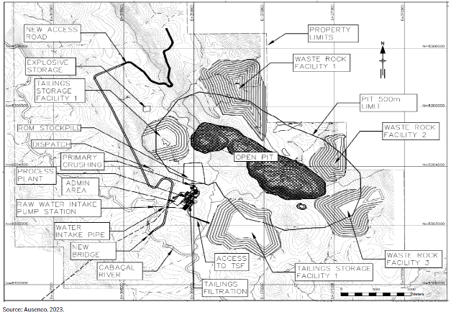
Technical Analysis – Site Layout and Surface Infrastructure
Tailings Storage
Two tailings storage facilities are planned
Facility 1 : South side of open pit limit
Facility 2: West side of uppermost pit limit
Waste Rock Storage
Three waste rock facilities are planned to the East and North of the open pit
ROM Stockpile
The mill feed is drawn from the run-of-mine stockpile located between on the West side of the open pit and North of the processing plant
Process Plant
Located to the West of the open pit, the processing facility is in close to the open pit and tailings facilities
Water Access
Water for mining and milling processes is available via a new water intake pipe that draws water from the Cabacal River. The water is to be stored on site in reservoirs close to the processing plant
Bridge Construction
A new bridge is planned for the new access road to cross the Cabacal River
Executive Summary Overview Investment Criteria Technical Analysis Financial Analysis Valuation Proposal

Slide 22
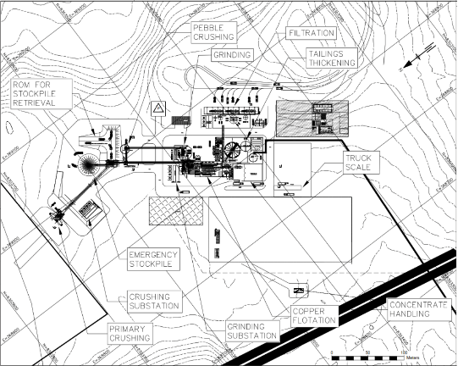
Meridian Project Processing and Milling
PEA Proposed Mineral Processing Plant (Mill)
PEA Proposed Mineral Processing Plant (Mill)
ROM Pile / Stockpile
Primary Jaw Crusher
SAG Milling with pebble crushing
EM Stockpile
Flotation
Gravity
Concentrate Thickening
Concentrate
Tailings
Executive Summary Overview Investment Criteria Technical Analysis Financial Analysis Valuation Proposal

Slide 23
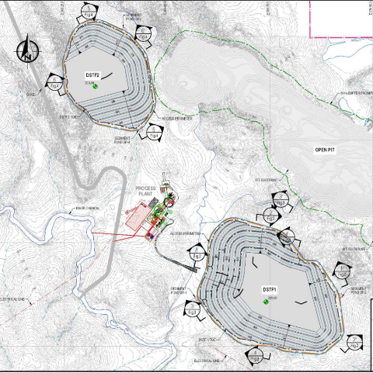
Meridian Project Tailings and Stockpile
Dry Stack Tailings facility
Tailings Storage Capacity – 55.6 Mt
62.75 m³ Waste Rock Storage Capacity
Non-Acid Generating Tailings
Sustainable Water Management
ESG Compliance and Forward Thinking Remediation
Strategic Site Selection
Executive Summary Overview Investment Criteria Technical Analysis Financial Analysis Valuation Proposal

Slide 24
Technical Analysis – Mitigating Risk
Risk Identified
Risk Mitigation
Block model completed using Multiple Indicator Kriging (MIK), which a less common technique
Validation of Mineral Resource Estimate using Ordinary Kriging or Inverse Distance Squared techniques
Surface rights are yet to be obtained
Brazil is known to be a mining friendly jurisdiction; project management team is Brazilian which eases communication with government agencies
Safety risk of underground openings from historical Room and Pillar mining
No expectation of unknown mine openings, care to be exercised when working in areas of prior mining activities
Lack of geotechnical knowledge
Pit slopes and other mine plans may need to be adjusted once more geotechnical information becomes available
Tailings categorized as Potentially Acid Generating (PAG)
Geotextiles, berm and soil liner planned to contain any potential AMD (acid mine drainage)
Environmental damage such as deforestation
Biodiversity to be maintained through reforestation. This can aid in restoring habitats for various species, while helping to maintain or increase biodiversity.
Executive Summary Overview Investment Criteria Technical Analysis Financial Analysis Valuation Proposal

Slide 25
Financial Analysis
Monthly Gold Price Movement – 20yrs
Gold Price Trendlines
Gold Price Trendline
1yr
3yr
5yr
Executive Summary Overview Investment Criteria Technical Analysis Financial Analysis Valuation Proposal

Slide 26
Financial Analysis
Analyst Expectations
Considerations
2025
2026
2027
2028
LT
1
Futures market expects the price of gold to go up in the immediate-short term
Average
2,598
2,551
2,479
2,402
2,169
Median
2,625
2,538
2,500
2,400
2,100
2
Price corrections historically follow gains of this magnitude for precious metals
Max
3,000
3,300
2,929
2,963
2,963
Min
2,000
1,900
1,900
1,900
1,750
3
Price correction in the short-medium term is expected, driven by lack of demand
Gold Futures Price
Monthly Movement of SPDR GLD Gold Index
Executive Summary Overview Investment Criteria Technical Analysis Financial Analysis Valuation Proposal

Slide 27
Financial Analysis
After-Tax IRR
Payback
Copper Peers
Lowest CAPX
Lowest US$/CuEq
Only Brazilian Company
Catalysts in the near term
Feasibility Study
Decision to Mine
Cabacal Production
Mine Corridor Development
2025
2027
2029
Onward
2026
2028
2030
Installation License
Santa Helena
Executive Summary Overview Investment Criteria Technical Analysis Financial Analysis Valuation Proposal

Slide 28
Financial Analysis
Properties
Jurisdiction
Owners
Development
AuEQ (Inferred oz)
AuEQ (Indicated oz)
AuEQ (Measured oz)
AuEQ (P&P oz)
Cabacal
Brazil
Meridian Mining
PEA
300,000
1,800,000
0
0
Almas
Brazil
Aura Minerals
Production
0
547,435
197,920
0
Eskay Creek
Canada
Skeena
FS
40,000
1,468,000
4,077,000
4,569,000
Railroad-Pinion
USA
Orla Mining
FS
0
1,895,000
480,500
0
Novador
Canada
Probe Gold
PEA
1,481,700
5,523,900
373,700
0
Los Ricos
Mexico
GoGold
FS
191,000
632,000
651,000
0
Ikkari
Finland
Rupert Resources
PFS
136,000
4,087,000
0
0
Windfall Lake
Canada
Osisko Mining
FS
3,358,462
3,775,995
298,973
0
Kone
Cote D'Iovire
Montage Gold
FS
400,000
4,870,000
0
0
Executive Summary Overview Investment Criteria Technical Analysis Financial Analysis Valuation Proposal

Slide 29
Financial Analysis
1
OPEX
CAPX
Cabacal – Updated PEA
With shareholder dilution
Scenario:
10%▲
30%▲
P/NAV
3.70
P/NAV
1.31
Profit Margin
7.60x
Profit Margin
2.05x
2
OPEX
CAPX
Cabacal – Updated Throughput
With shareholder dilution
15%▲
30%▲
P/NAV
4.37
P/NAV
1.61
Profit Margin
9.16x
Profit Margin
2.74x
3
OPEX
CAPX
Cabacal & Santa Helena
With shareholder dilution
15%▲
30%▲
P/NAV
6.78
P/NAV
2.49
Profit Margin
14.77x
Profit Margin
4.79x
Executive Summary Overview Investment Criteria Technical Analysis Financial Analysis Valuation Proposal

Slide 30
Financial Analysis
1
OPEX
CAPX
Best Case @ $2500
With shareholder dilution
Cases:
15%▲
0%▲
P/NAV
7.53
P/NAV
2.77
Profit Margin
16.51x
Profit Margin
5.44x
2
OPEX
CAPX
Base Case @ $2000
With shareholder dilution
15%▲
30%▲
P/NAV
6.78
P/NAV
2.49
Profit Margin
14.77x
Profit Margin
4.79x
3
OPEX
CAPX
Worst Case @ $1800
With shareholder dilution
15%▲
50%▲
P/NAV
5.80
P/NAV
2.13
Profit Margin
12.49x
Profit Margin
3.95x
Executive Summary Overview Investment Criteria Technical Analysis Financial Analysis Valuation Proposal

Slide 31
Financial Analysis
Sensitivity:
+10%
Gold Price
C$0.36
OPEX
C$0.15
CAPX
C$0.03
Milling throughput = +50% profit
Santa Helena = +19% profit
Executive Summary Overview Investment Criteria Technical Analysis Financial Analysis Valuation Proposal

Slide 32
Financial Analysis
Recommendation: Meridian Mining
G Mining Ventures
Speculation: BUY
Valuation: C$1.72/share
Share price has built in all potential
Updated PEA
5%
CA$1.31
No near-term catalysts to return profit
Bargain Value
Base Case – S2
60%
CA$1.61
Potential issues with CentroGold
Feasibility
Best Case –S3
20%
CA$2.49
Omai Gold Mines
Street
15%
CA$1.30
Technicals
Profit: 3.01x
Technical risk associated with Gilt Creek
High financing risk
Heavy reliance on MNA outcome
Executive Summary Overview Investment Criteria Technical Analysis Financial Analysis Valuation Proposal

